Slide 1


Importance-Performance Analysis
Georgia Southern University
Parents Data
Twinkle Patel

Slide 2
Purposes of Importance-Performance Analysis
Evaluate Georgia Southern University by comparing the importance of factors to performance in those areas.
Analysis highlights strengths and identifies opportunities for improvement to meet better expectations.
Identify areas where Importance is high, performance is low
Focus on improving overall performance.

Slide 3

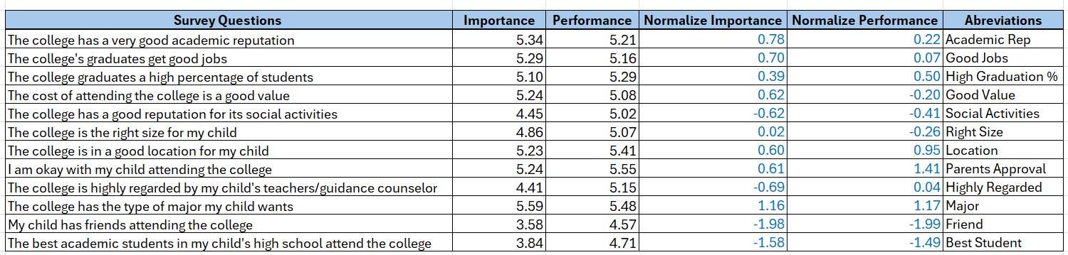
Survey Results

Slide 4
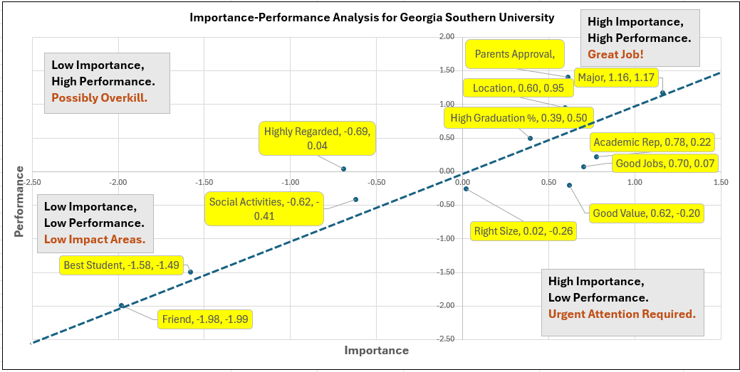

Slide 5




Areas Doing Great
Parents Approval
Location
High Graduation %
Major

Slide 6
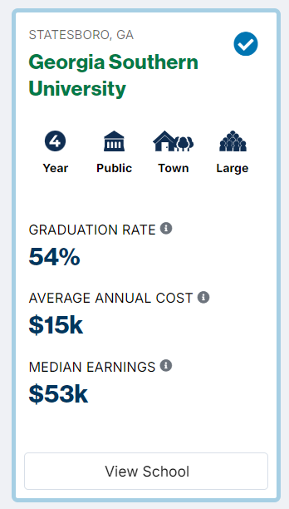
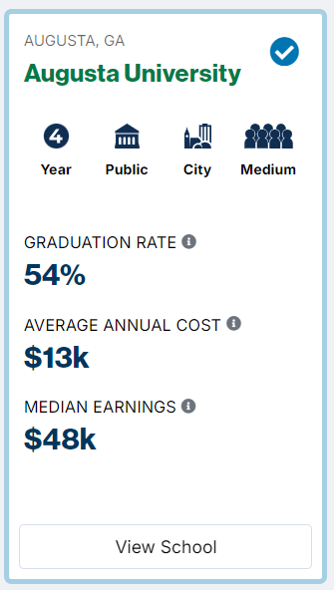
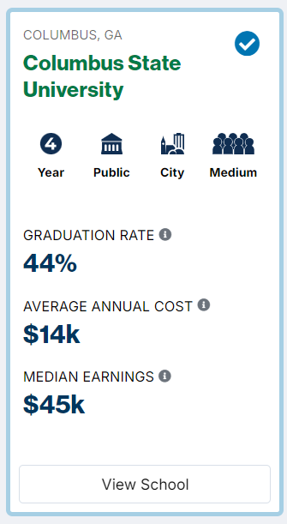
Needs Improvement/Recommendations
Good Value:
Georgia Southern has a high average annual cost, even though it has the same graduation rate as Augusta University, which is more affordable
Highlight financial aid opportunities
Offer flexible payment options like Payment plans, Discounts, and early-bird offers
Introduce online or hybrid programs

Slide 7
Needs Improvement/Recommendations
Right Size:
Keep class sizes balanced for better student engagement and collaboration.
Ensure the student body size matches available resources, such as housing and libraries, to avoid overcrowding.
Academic reputation:
Specialized programs in high-demand fields (e.g., STEM, business, health sciences)
Gather student feedback through surveys, focus groups, and suggestion boxes.
Good Jobs:
Enhance career services by offering comprehensive support, including resume writing, interview preparation, job search strategies, and personalized career counseling to help students explore career options and set achievable goals.
Promote and Highlight job placement rates, average salaries, and career outcomes on the college’s website.

Slide 8

Thank You!
Georgia Southern University Data Analysis
Parents’ Sample
Twinkle Patel

